Slide 1
ICS2 EO Self-Conformance Test (CT)
Support by NAs
ICS2 Release 2 EO Self-CT Campaign (July 2022 – February 2023)
June 2022

Slide 2

Agenda
Welcome
ICS2 Release 2 Conformance Environment Overview
Planning and Milestones
Conformance Testing Organisation
  Conformance Testing Scope
  Roles and Responsibilities during CT
  Communication during CT
  CT Reporting
Conformance Testing Procedure

Slide 3
Agenda
How to access STI-STP in CONF
Connection to ICS2 Conformance Environment
  Certificate Requirements
  Registration in UUM&DS
  Establishment of Access Point(s)
  Connectivity Verification
Use of STI-STP for the EO CT campaign
ICS2 R2 Documentation for EOs
Questions and Answers

Slide 4
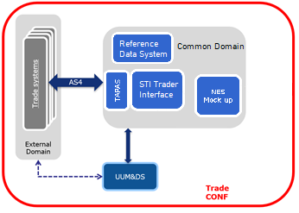
2. ICS2 Release 2 Conformance Environment Overview
Trader’s system: It is the system of the Sender (Economic Operator or IT Service Provider)

Slide 5
3. Planning and Milestones
NPP
NPP
NPP
EO Conformance Testing Campaign Timeline
EO Project Plan (PP)
How to fill in the EO PP
Where to communicate the EO PP
NPP
EO PP
(Project Plan)
NPP (National Project Plan)

Slide 6
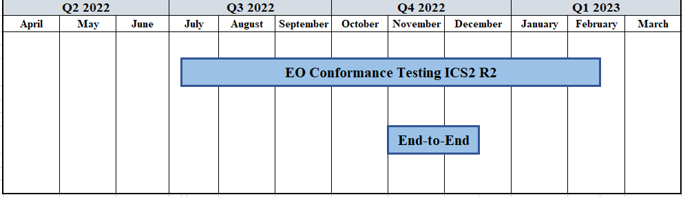

3. Planning and Milestones
EO Conformance Testing Campaign Timeline
It is strongly recommended for EOs to start the campaign at the first half of the CT timeline

Slide 7
3. Planning and Milestones
EO Project Plan (1 out of 2)
It is attached in Annex A of EO-CTOD for R2
It includes the milestones regarding the EO Self-Conformance Test Campaign
It is communicated to the NSD
It is submitted by the deadline set by DG TAXUD

Slide 8
3. Planning and Milestones
EO Project Plan (2 out of 2)
It is subject to change during the entire CT campaign
NSD will incorporate every EO Project Plan in their National Project Plan
NSD will keep an open channel with their respective EOs in order to request and receive potential updates in the EO CT plan
Member States maintain an EO Consolidated CT Report
DG TAXUD reserves the right to propose alternative CT dates

Slide 9

3. Planning and Milestones
How to fill in the EO PP
EO Project Plan
Remember: You can fill in only the light grey cells from columns B, C and E

Slide 10



3. Planning and Milestones
Where to communicate the EO PP
The MS from which EO obtained EORI number of the Sender
Economic Operator
National Service Desk (NSD)
EO must communicate the EO Project Plan in the NSD of its responsible MS
Any change in the initial plan should be communicated in a timely manner

Slide 11
4. Conformance Testing Organisation
Conformance Testing Scope
Roles and Responsibilities during CT
Communication during CT
Conformance Testing Reporting

Slide 12
4. Conformance Testing Organisation
Conformance Testing Scope
The Self-Conformance Testing campaign aims at self-testing the compliance of the EO systems with the system-to-system (S2S) interface specifications of the Harmonised Trader Interface (HTI)
This includes:
Compliance with AS4 interface profile
Use of Digital Certificates
Semantic validation of the messages sent by traders
Testing the notifications that are dispatched towards traders & their responses to ICS2 requests

Slide 13
4. Conformance Testing Organisation
Roles and Responsibilities during CT
DG TAXUD Contractors
Member State
DG TAXUD
Economic Operator
EO Side
National Side
Central Side

Slide 14
4. Conformance Testing Organisation
Roles during CT
Economic Operator
Economic Operator (EO)
National Customs Authority (NA)
National Service Desk (NSD) / National Project Team
ITSM3-TES CT Team
DG TAXUD ICS2 Testing Manager
IT Service Provider (ITSP)
DG TAXUD ICS2 System Owner
DG TAXUD ICS2 Business Team
DG TAXUD ICS2 Project Team
Central Service Desk (CSD)
ITSM3 Contractors (3rd Level Support)
Member State
DG TAXUD
DG TAXUD
Contractors
Central side
National side
EO side

Slide 15
4. Conformance Testing Organisation
Responsibilities – Economic Operator (EO) (1 out of 2)
Reads and understands in depth the relevant CT documentation
Defines an EO SPOC as a focal point in the coordination with NA (NSD)
Obtains the required digital certificates (i.e., for TLS and for sealing)
Implements the AS4 access point according to HTI-ICD specifications
Obtains an EORI by a responsible MS
Registers the digital sealing certificate in UUM&DS in CONF environment
Ensures the procurement of the latest CLs applicable for R2.0 from DDS2 COL, in order to prepare valid messages to be sent from their system to STI/ICS2

Slide 16
4. Conformance Testing Organisation
Responsibilities – Economic Operator (EO) (2 out of 2)
Requests the creation of users & roles in UUM&DS CONF (for access in EUCTP & STI-STP)
Provides to responsible MS a plan for EO Self-Conformance Testing
Reports their CT campaign progress to their respective NSD
Fulfills the EO CT prerequisites
Self-executes successfully through STI-STP the required test business scenarios
Requests support from NSD in case errors are detected or information is needed
EO SPOC follows up tickets that were registered in SYNERGIA ESS by NSD

Slide 17
4. Conformance Testing Organisation
Responsibilities – IT Service Provider (ITSP)
An IT Service Provider is a legal person contracted by a Person filing for services involving the delivery and reception of messages to and from ICS2 TI
Can provide business services to multiple EOs
Should register a conformance test campaign for each business role that intends to perform
Runs the campaign by testing all the pre-defined business scenarios successfully
When an ITSP provides services to several EOs of the same business role, it is required to perform only one campaign during self-conformance testing

Slide 18


4. Conformance Testing Organisation
Responsibilities – National Customs Authority (NA) (1 out of 3)
In the interaction with EOs, National Customs Authority is represented by its National Service Desk (NSD)
National Customs Authority (NA)
National Service Desk (NSD)

Slide 19
4. Conformance Testing Organisation
Responsibilities – National Customs Authority (NA) (2 out of 3)
Ensures the communication, coordination and the CT planning with the EO
Registers Economic Operators by using other systems: EOS and UUM&DS
Manages any process related to the registration, identification and maintenance of the identities of the Economic Operators and their representatives, in their Identity & Access Management (IAM) systems (connected to the UUM&DS)
Provides the EO CT Project Plan through NPP to DG TAXUD
Verifies and validates the sealing certificate registration from the EO

Slide 20
4. Conformance Testing Organisation
Responsibilities – National Customs Authority (NA) (3 out of 3)
Organises and delivers trainings to EOs
Provides to EOs the UUM&DS user/roles needed to access EUCTP & STI-STP in CONF
Checks the business & technical readiness of EOs before they start sending ENS to the STI
Maintains the EO Consolidated Report to monitor the EO Self-Conformance Testing progress (for the EOs that pertain under their responsibility)
Provides the service desk (NSD) support to EOs for CT related incidents
Acts as an escalation point along with DG TAXUD

Slide 21
4. Conformance Testing Organisation
Responsibilities – National Service Desk (NSD) (1 out of 2)
The role of the National Service Desk is to provide meaningful support to the EOs in the activities that concern the EO Self-Conformance Testing
Provides assistance in the upload & registration of the sealing certificate in UUM&DS CONF
Supports the establishment of EO’s AS4 Access Point(s)
Follows-up and supports EOs through ICS2 MON&BS during Self-conformance test campaign
Logs any issues/incidents found during EO Self-Conformance Test campaign that need to be investigated by NSD or CSD

Slide 22
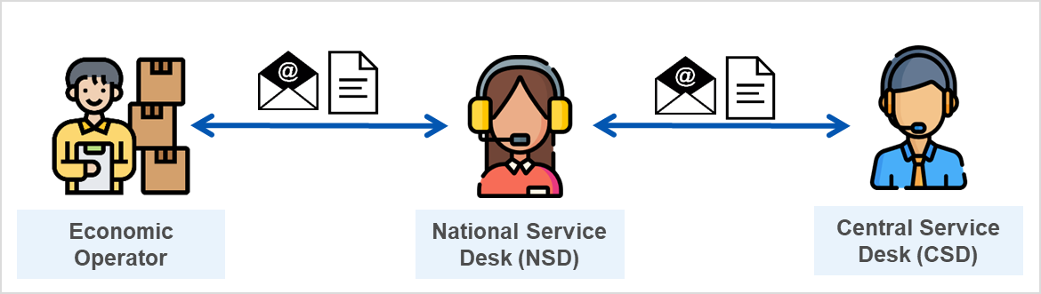
4. Conformance Testing Organisation
Responsibilities – National Service Desk (NSD) (2 out of 2)
Resolves any issue/incident occurred during the EO Self-Conformance Test campaign or dispatch them to CSD in case this is related to ICS2 central components
Follows-up the CT incidents and shares the provided feedback to relevant EOs
Facilitates the EO in the information exchange flow from NSD towards CSD and vice versa

Slide 23
4. Conformance Testing Organisation
DG TAXUD
DG TAXUD
Central Service Desk (CSD)
ITSM Contractors

Slide 24
4. Conformance Testing Organisation
Responsibilities – DG TAXUD
Provides the central Access Point and STI services for the Conformance Testing
Delivers the training and relevant training material to MSs
Produces and publishes on Europa page & CIRCABC group the ICS2 CFSS & CTSS
Manages the ITSM Contractors
Provides support to ITSM contractors when is needed
Acts as an escalation point in the context of the daily operation of the NSD

Slide 25
4. Conformance Testing Organisation
ITSM Contractors of DG TAXUD
ITSM Contractors of DG TAXUD
ITSM3-Operations
ITSM3-TES

Slide 26
4. Conformance Testing Organisation
Responsibilities – ITSM Contractors of DG TAXUD - TES
Handles issues through DG TAXUD ticketing system (SYNERGIA) dispatched by NSD and logged to CSD
Consolidates weekly the EO CT plan provided by MS
Provides training session to MS regarding EO Self-Conformance Testing execution
Hosts the Conference Calls between the EOs and ITSM3-TES/DG TAXUD if requested by EO’s respective NSD
Registers incidents regarding technical or business-related defects related to central components for further investigation by the development team or/and DG TAXUD
Provides report on the EO CT progress based on data extracted from ICS2 MON&BS
Performs risk analysis and escalates to DG TAXUD any blocking issue identified during the EO Self-Conformance Testing

Slide 27
4. Conformance Testing Organisation
Responsibilities – ITSM Contractors of DG TAXUD - OPS
Implements configurations* at TAPAS and STI level for the establishment of the connectivity between TAPAS and EO System AS4 Access Point(s)
Configures and maintains the conformance environment
Handles issues through DG TAXUD ticketing system (SYNERGIA) dispatched by NSD
* Based on the configuration details provided by the EO through STI-STP

Slide 28
4. Conformance Testing Organisation
Responsibilities – Central Service Desk (CSD)
The role of Central Service Desk is to provide support to NSD in case of EO CT related issues that cannot be resolved at NSD level
Dispatches to the appropriate central support teams any issue/incident which is related to ICS2 central components
Follows the incident management flow defined in ICS2 Helpdesk specifications

Slide 29

4. Conformance Testing Organisation
Communication during CT campaign
Continuous communication and synchronisation between all the involved parties are essential during the Conformance Testing activities
EO through EO SPOC
National Customs Authority (NA) through National Service Desk (NSD)
DG TAXUD
ITSM Contractors through
Central Service Desk (CSD)

Slide 30
4. Conformance Testing Organisation
Communication during CT campaign
EO through EO SPOC
Economic Operator defines an EO SPOC to be the focal point between EO and NA
EO SPOC provides any required information (e.g., CT planning) to NA through NSD
During the CT execution EO SPOC can request support from NSD in case errors are detected or information is required
EO SPOC should follow up any opened ticket (registered by NSD) for updates
Remember: Any request from EO should be addressed always to National Service Desk

Slide 31
4. Conformance Testing Organisation
Communication during CT campaign
National Customs Authority through NSD (1 out of 2)
NA through its NSD provides service desk support to EOs for CT related incidents
NSD receives any issue/request that was raised by EO SPOC
NSD analyses/investigates any issue/incident occurred during the EO Self-Conformance Test campaign
Upon analysis, NSD provides a solution by replying to the EO SPOC
If further analysis is required at central level (ICS2 central components), NSD logs a ticket to CSD
NSD follows-up any opened ticket and shares the provided feedback to the relevant EO SPOC

Slide 32
4. Conformance Testing Organisation
Communication during CT campaign
National Customs Authority through NSD (2 out of 2)
The following table calculates the target and limit time values of NSD for incident management
Incident Management Time
Priority | Target Time | Limit Time
4 – Critical | 2 Hours | 5 Hours
3 – High | 10 Hours | 1 Business Day
2 – Medium | 2 Business Days | 3 Business Days
1 – Low | 4 Business Days | 5 Business Days
NSD should respect the determined Trans-European Systems SLA for Service Desk procedures

Slide 33
4. Conformance Testing Organisation
Communication during CT campaign
ITSM Contractors through CSD (1 out of 2)
CSD receives the registered ticket from NSD and sets the priority (based on urgency & impact)
CSD dispatches the ticket to the appropriate central support teams (ITSM Contractors) according to the nature of the issue/request
ITSM Contractors analyse/investigate any issue/request from the dispatched tickets that are logged in SYNERGIA
Upon analysis, ITSM Contractors provides a solution by updating the relevant ticket
Once solution is provided, CSD assigns back the relevant ticket to NSD
The referred tickets are related to incidents with Central Components

Slide 34
4. Conformance Testing Organisation
Communication during CT campaign
ITSM Contractors through CSD (2 out of 2)
The following table calculates the priority of an incident based on urgency and impact parameters:
Urgency | Impact | Low | Medium | High
Low |  | Low | Medium | High
Medium |  | Medium | High | Critical
High |  | High | Critical | Critical

Slide 35
4. Conformance Testing Organisation
Communication during CT campaign
DG TAXUD
Manages the ITSM Contractors
Ensures enough service availability of the CSD and ITSM Contractors for supporting EO CT campaign
Provides support to ITSM contractors when needed (for ticket handling)
Acts as an escalation point for tickets regarding technical or business-related defects related to central components

Slide 36





4. Conformance Testing Organisation
Communication during CT campaign
Communication Map
EO
NA
Request/Issues regarding CT
Economic Operator SPOC
National Service Desk (NSD)
Issues related to ICS2 central components
Central Service Desk (CSD)
ITSM Contractors
DG TAXUD
ITSM Business Support
ITSM Technical Support

Slide 37

4. Conformance Testing Organisation
Conformance Testing Reporting
Members States maintain the EO Consolidated Report to monitor the EO Self-Conformance Testing progress of the EOs that fall under their responsibility
Member States through ICS2 MON&BS with the use case ''Consult EO Self-Conformance Campaign'' can:
Consult the registered EO Self-conformance Test Campaigns in CONF
Download a query of the registered EO Self-Conformance Test Campaigns in CONF
MS Service Support – Monitoring Operator
STI – STP
User Interface
Member State
MS Service Support – Messages Operator

Slide 38

5. Conformance Testing Procedure
Prerequisites
Conformance Campaign Set up and Execution

Slide 39
5. Conformance Testing Procedure
Prerequisites (1 out of 2)
Prerequisites should be fulfilled by each entity in order EO to be ready for starting the Self-Conformance Testing
Action | EO | MS | ITSM OPS | Reference
1. Set up the necessary infrastructure to perform the tests | ✓ |  |  | HTI-ICD
2. Communicate EO plan for Self-conformance execution to MS | ✓ |  |  | Annex A – EO CTOD
3. Communicate EO plan for Self-conformance execution to DG TAXUD |  | ✓ |  | 2.1.3 – EO CTOD
4. Obtain EORI from National Customs Authority | ✓ | Support |  | 2.1.1 – EO CTOD
5. Obtain the required digital certificates (i.e., for TLS and for sealing) | ✓ |  |  | 3.3.1– EO CTOD

Slide 40
5. Conformance Testing Procedure
Prerequisites (2 out of 2)
Action | EO | MS | ITSM OPS | Reference
6. Develop and validate EO Access Point(s) according to HTI – ICD | ✓ | Support |  | HTI-ICD
7. Create UUM&DS user and roles in CONF for accessing EUCTP & STI-STP | ✓ | Support |  | 2.7 – EO CTOD
8. Connect to ICS2 Conformance Environment
8.1 Upload and register the sealing certificate in UUM&DS in CONF environment | ✓ | Support |  | 3.1 – EO CTOD
8.2 Establishment of EO’s AS4 Access Point(s) through STI-STP in CONF | ✓ |  |  | 3.2.1 – EO CTOD
8.3 Configure EO’s AS4 Access Point(s) at TAPAS & STI level in CONF |  |  | ✓ | 3.2.1 – EO CTOD
8.4 Verify proper establishment of the connectivity | ✓ |  |  | 3.2.2 – EO CTOD

Slide 41
5. Conformance Testing Procedure
Conformance Campaign Set up and Execution (1 out of 2)
Actions that should be accomplished to set up and execute the EO Self-Conformance Campaign
Action | EO | MS | ITSM OPS | Reference
1. Set up Conformance Test campaign in STI-STP | ✓ |  |  | 2.8.1 – EO CTOD
2. Run Conformance Test campaign in STI-STP
2.1 Perform Self-conformance testing in STI-STP | ✓ |  |  | 2.8.2 & 4 – EO CTOD
2.2 Follow up and support EO Self-CT through ICS2 MON&BS |  | Support |  | 2.5 – EO CTOD

Slide 42
5. Conformance Testing Procedure
Conformance Campaign Set up and Execution (2 out of 2)
Action | EO | MS | ITSM OPS | Reference
3. Conformance Test campaign Validation
3.1 Consult EO-SELF CT campaign status via STI-STP UI | ✓ |  |  | 3.5.2. – STI-STP UCS
3.2 Consult EO Self-CT campaign status via ICS2 MON&BS UI |  | ✓ |  | 2.5 – EO CTOD
3.3 Upload in PROD via MON&BS UI a file with the successful EO Self-Conformance Test Campaigns that have been downloaded from CONF |  | ✓ |  | ICS2 – MON UCS
4. Implement activities after Conformance Test campaign
4.1 Establishment of EO’s AS4 Access Point(s) through STI-STP in PROD | ✓ |  |  | 6 – EO CTOD
4.2 Configure EO’s AS4 Access Point(s) at TAPAS and STI level in PROD |  |  | ✓ | 6 – EO CTOD
4.3 Complete activities defined in the Operational Checklist | ✓ |  |  | Annex B – EO CTOD

Slide 43
6. How to access STI-STP in CONF
How to grant access in STI-STP CONF
STI-STP Roles Requirements

Slide 44

6. How to access STI-STP in CONF
How to grant access in STI-STP CONF (1 out of 2)
Business scenarios will be triggered from the ICS2 STI STP conformance campaign screen(s), dedicated solely for the purpose of an EO user to configure and execute the conformance test campaigns
EUCTP
EO or ITSP
STI-STP
User Interface
UUM&DS authorisation
Access validation
Customs Representative

Slide 45

6. How to access STI-STP in CONF
How to grant access in STI-STP CONF (2 out of 2)
EOs or Customs Representatives can access STI-STP by accessing first the EU Customs Trader Portal (EUCTP) via the internet or the website of their responsible National Customs Authority
EUCTP: https://conformance.customs.ec.europa.eu/gtp
Access in the EUCTP Portal is validated and managed by the UUM&DS

Slide 46
6. How to access STI-STP in CONF
STI-STP Roles Requirements (1 out of 3)
The following roles alongside with their key functionalities are required for an EO to perform EO Self-Conformance Testing through STI-STP:
Remember: EOs or Customs Representatives should have UUM&DS business profiles to grant the access rights of the required STI-STP roles
Economic Operator Declarant (EO-DECL)
  Search/View Submission following EUCTP rules
  STI-STP Search Messages (View ENS Filing with Declarant/Representative EORI)
  Manage Preferences (read-only access)
  Consult CONF Test Campaign (only in CONF environment)

Slide 47
6. How to access STI-STP in CONF
STI-STP Roles Requirements (2 out of 3)
Economic Operator Representative (EO-REP)
  Search/View Submission following EUCTP rules
  STI-STP Search Messages (View ENS Filing with Declarant/Representative EORI)
  Manage Preferences (read-only access)
  Consult CONF Test Campaign (only in CONF environment)
Economic Operator Configurator (EO-CONF)
  Manage Preferences-Access Point Configuration (write access)
  Register / Consult CONF Test Campaign (only in CONF environment)

Slide 48
6. How to access STI-STP in CONF
STI-STP Roles Requirements (3 out of 3)
Person Notifying Arrival (EO-PNA)
  Search/View Submission following EUCTP rules
  STI-STP Search Messages (View ENS Filing with Declarant/Representative EORI)
  Consult CONF Test Campaign (only in CONF environment)
Notify Party (EO-NOP)
  STI-STP Search Messages (View ENS Filing with Declarant/Representative EORI)
  Consult CONF Test Campaign (only in CONF environment)
One user can have more than one role, for example EO-DECL and EO-CONF

Slide 49
7. Connection to ICS2 Conformance Environment
Certificate Requirements
UUM&DS prerequisites and procedures
How to establish communication to TAPAS
Connectivity Verification

Slide 50
7. Connection to ICS2 Conformance Environment
Certificate Requirements
To ensure that only registered and authorised parties can deliver and receive messages to and from the TIs, the TI uses a registration and authorisation mechanism based on UUM&DS. This occurs at functional level
An EO or its ITSP should obtain 2 certificates:
A TLS (Transport Layer Security) certificate
A digital sealing certificate

Slide 51
7. Connection to ICS2 Conformance Environment
Certificate Requirements – TLS certificate
Obtain a certificate from a trusted Certificate Authority (CA) to be used at the transport layer (https) for identifying itself following the 2-way TLS security mechanisms
A Trusted CA in the TLS context can be a commercial CA trusted by DG TAXUD
The TLS certificate does not require registration
The same TLS certificate that was used in CONF can be used also for PROD
CAs for both categories are published in https://esignature.ec.europa.eu/efda/tl-browser/#/screen/home

Slide 52
7. Connection to ICS2 Conformance Environment
Certificate Requirements – Sealing certificate
Obtain a digital sealing certificate to be used for sealing at message layer, which should be registered in the National UUM&DS Application or in the Central UUM&DS Application
The certificate should be registered in the National UUM&DS or in the Central UUM&DS Application
In case that an EO uses an ITSP, the certificate registration is implemented by the ITSP
The same sealing certificate that was used for conformance testing can be used also for the production. In that case, the sealing certificate must be registered also in UUM&DS in PROD

Slide 53
7. Connection to ICS2 Conformance Environment
Certificate Requirements – Certificate Authorities (1 out of 3)
Sealing certificate must be issued by a Certificate Authority (CA) which is included:
Either in the official EU wide LOTL*
Or in the National Customs Alternate List of the Member State to whom in National UUM&DS the certificate is about to be registered
* The actual content of LOTL is managed and published by each MS

Slide 54
7. Connection to ICS2 Conformance Environment
Certificate Requirements – Certificate Authorities (2 out of 3)
The Certificate Authorities (CAs) on the LOTL can be divided into two categories:
CAs that issue qualified certificates
CAs on the LOTL that issue non-qualified certificate for e-signature/sealing
CAs for both categories are published in: https://esignature.ec.europa.eu/efda/tl-browser/#/screen/home

Slide 55
7. Connection to ICS2 Conformance Environment
Certificate Requirements – Certificate Authorities (3 out of 3)
Can an EO acquire a certificate from a CA not presented in the LOTL?
Yes, however, the CA should be included in National Customs Alternate List of the MS of registration
In the previous case, is there any restriction?
Yes, before acquiring a sealing certificate not included in the LOTL, the NA of registration should be consulted. NA will decide if the CA can be added to its alternate list
Who manages the National Customs Alternate List ?
MSs are responsible for managing their National Customs Alternate List

Slide 56
7. Connection to ICS2 Conformance Environment
Certificate Requirements – Certificates on Central Side (1 out of 2)
On ICS2 central side, the TAPAS conformance service is available at: https://customs.ec.europa.eu:8445/domibus/services/msh
Regarding the 2-way SSL that is implemented, the GlobalSign CA chain is used with conformance.customs.ec.europa.eu:8445 service
Download from here:
https://secure.globalsign.net/cacert/Root-R3.crt
https://secure.globalsign.com/cacert/gsrsaovsslca2018.crt

Slide 57
7. Connection to ICS2 Conformance Environment
Certificate Requirements – Certificates on Central Side (2 out of 2)
Regarding the sealing/signing certificate, there is a DG TAXUD certificate for singing the conformance messages:
Certificate Attributes | Common Name | Organisational Unit | Organisation | Locality | Country Name
Owner | TAPAS_gw | SPEED2ng TL | SPEED2ng | Brussels | BE
Issuer | SPEED2.CONF.CA | SPEED2 | DG TAXUD | TAXUD DC | BE

Slide 58
7. Connection to ICS2 Conformance Environment
UUM&DS prerequisites and procedures
To access UUM&DS web services, an Economic Operator or a Customs Representative must be registered in UUM&DS
EO or ITSP
UUM&DS Web Services
UUM&DS authorisation
Customs Representative

Slide 59
7. Connection to ICS2 Conformance Environment
UUM&DS – Business Profiles (1 out of 3)
A UUM&DS user must have at least one Business Profile to access an application protected by a UUM&DS Policy
For sealing certificate registration on Central UUM&DS Application the business profile BP_MANAGE is required:
BP_MANAGE
Central UUM&DS Application
EO or ITSP
Certificate registration

Slide 60
7. Connection to ICS2 Conformance Environment
UUM&DS – Business Profiles (2 out of 3)
In the scope of CT Campaign, an EO or a Customs Representative should have business profiles to grant the access rights of the required STI-STP roles
The required business profiles are STISTP_EXECUTIVE and/or STISTP_CONFIGURATOR:
EO or ITSP
STISTP_EXECUTIVE
STI – STP
User Interface
STISTP_CONFIGURATOR
Customs Representative

Slide 61
7. Connection to ICS2 Conformance Environment
UUM&DS – Business Profiles (3 out of 3)
UUM&DS Business Roles vs Corresponding STI-STP roles
UUMDS type of actor | Delegated from | UUMDS business profile configured as available | STI-STP role
Economic Operator (Trader and ITSP) |  | EXECUTIVE | EO-DECL
 |  | CONFIGURATOR | EO-CONF
 |  | EXECUTIVE_LIMITED | EO-PNA
 |  | CONSULTATIVE | EO-NOP
Employee* | Economic operator | EXECUTIVE | EO-DECL
 |  | CONFIGURATOR | EO-CONF
 |  | EXECUTIVE_LIMITED | EO-PNA
 |  | CONSULTATIVE | EO-NOP
Customs Representative |  | EXECUTIVE | EO-REP
 |  | CONFIGURATOR | EO-CONF
Employee* | Customs Representative | EXECUTIVE | EO-REP
 |  | CONFIGURATOR | EO-CONF
An EO or Customs Representative (delegator) can delegate all or a subset of their business profiles to any of their employee (delegate)

Slide 62
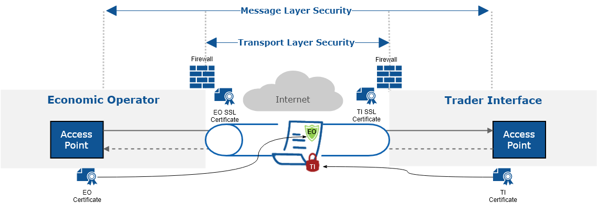
7. Connection to ICS2 Conformance Environment
UUM&DS – Sealing Certificate Registration (1 out of 4)
UUM&DS will be used to verify that the sender has the authorisation to send and receive messages to and from the STI
The senders that will be authorised for exchanging messages with the STI need to register their identification number (EORI) and the certificate that will be used for sealing the AS4 messages

Slide 63
7. Connection to ICS2 Conformance Environment
UUM&DS – Sealing Certificate Registration (2 out of 4)
UUM&DS will be used to verify that the sender has the authorisation to send and receive messages to and from the STI
CONF
environment
Certificate registration
National UUM&DS Application
Customs Representative
EO or ITSP
Certificate registration
Central UUM&DS Application
BP_MANAGE

Slide 64
7. Connection to ICS2 Conformance Environment
UUM&DS – Sealing Certificate Registration (3 out of 4)
Customs & Tax EU Learning Portal offers an online course including specific information on the use of UUM&DS
Attend course here:
https://customs-taxation.learning.europa.eu/course/view.php?id=494&section=1
Outcomes:
Confidently work with the UUM&DS
To carry out certificate registration
Apply delegation & roles assignments authorisation tasks within the UUM&DS
It is strongly recommended for all EOs and their Customs representatives to attend this online 30-minute course prior to interaction with UUM&DS

Slide 65
7. Connection to ICS2 Conformance Environment
UUM&DS – Sealing Certificate Registration (4 out of 4)
‘UUM&DS Central Certificate Registration’ User Manual includes information regarding the certificate registration in the Central UUM&DS Application
Additional Information:
Section 3.1 from EO-CTOD
Annex D from EO-CTOD
It is strongly recommended to initiate the process of obtaining & registering the required certificates well in advance before CT campaign commences, to ensure that no delays will occur in the initial EO CT plan

Slide 66
7. Connection to ICS2 Conformance Environment
How to establish communication to TAPAS (1 out of 4)
For the CT activities, EO or ITSP should establish one or more Access Point(s) for exchanging messages with the ICS2 STI via TAPAS
Deploy one or more Access Point(s) according to HTI – ICD specifications
Obtain a TLS certificate to be used at the transport layer (https) for identifying itself following the 2-way TLS security mechanisms
Obtain a sealing certificate to be used for sealing at message layer
Sender must be registered by National Customs Authorities following the agreed national procedure This includes the upload of the sealing certificate (on Central or National UUM&DS Application)

Slide 67
7. Connection to ICS2 Conformance Environment
How to establish communication to TAPAS (2 out of 4)
Senders’ (EO or ITSP) AS4 Access Point(s) configuration is implemented through STI-STP
Configure their own AS4 Access Point(s) in STI-STP
  Log in on EUCTP and access STI-STP via UUM&DS authentication and identification
  Select ''Manage Preferences'' from STI-STP menu
  Add the required information on ''Party ID definition''
Provide the Party ID (format according to HTI-ICD)
Define Message Exchange Pattern (“push” or “pull”)
Provide the Endpoint (i.e., URL) (Available if the MEP is “push”)
Provide the Certificate Authority that issues the TLS certificate
Insert Technical details (Name, Email address, Phone)

Slide 68
7. Connection to ICS2 Conformance Environment
How to establish communication to TAPAS (3 out of 4)
Senders’ (EO or ITSP) AS4 Access Point(s) configuration is implemented through STI-STP
Configure their own AS4 Access Point(s) in STI-STP
  Add information on ''Default communication path''
Select Business domain (Postal, Maritime, Air, Rail, Road, Express)
Select Communication path (UI, S2S)
Party Id ID (Mandatory in case the communication path is S2S)

Slide 69
7. Connection to ICS2 Conformance Environment
How to establish communication to TAPAS (4 out of 4)
Upon provision of the required information, an email will be launched to CSD with a request to create a ticket in Synergia SMT asking ITSM Contractor [OPS] to configure this new access point
STI-STP
(Manage Preferences)
CSD
EO or ITSP
ITSM OPS
Provide information for Access Point Configuration
Automate Email notification to CSD
Ticket for new access point configuration
Change activities must take place on central side (at TAPAS and STI level) for the EO registration

Slide 70
7. Connection to ICS2 Conformance Environment
Connectivity Verification (1 out of 2)
Upon implementation of the configuration activities, the establishment of the connectivity between TAPAS and EO System AS4 Access Point(s) must be verified
To do so:
EO System should send a test message to TAPAS as described in section 4 of ICS2 Test Design Specifications for EO Conformance Test Cases
The TAPAS system verifies the digital signature using UUM&DS and validates that the EORI embedded in the eb:From/PartyId is associated with the message in the embedded certificate using the information registered in UUM&DS
Then, TAPAS automatically replies with an AS4 signal message allowing the EO system to verify the correct connection

Slide 71


7. Connection to ICS2 Conformance Environment
Connectivity Verification (2 out of 2)
Signal message indicates whether the UUM&DS configuration is correct or not
If the initial test message fails due to UUM&DS issues, it will generate an authorisation AS4 error message
Only when successful connectivity is verified, EO is ready for starting Self-Conformance Testing execution

Slide 72
8. Use of STI-STP for the EOs CT campaign
EO Self-Conformance Test Execution steps:
  Set Up a Conformance campaign
  Run the Conformance Campaign
  Validate the Conformance Campaign Results

Slide 73
8. Use of STI-STP for the EOs CT campaign
Set Up a Conformance Campaign (1 out of 3)
The following roles alongside with their key functionalities are required for an EO to perform EO Self-Conformance Testing through STI-STP:
Pre-Conditions:
  UUM&DS access has been granted
  Sealing certificate is uploaded and registered successfully in UUM&DS CONF
  EO user is successfully logged into EUCTP via UUM&DS authentication & identification in CONF
  The AS4 connectivity between the EO System and ICS2 is in place (is configured via the STI-STP Manage Preferences)
  Notification to NSD about the execution date once dates confirmed

Slide 74
8. Use of STI-STP for the EOs CT campaign
Set Up a Conformance Campaign (2 out of 3)
Remember: AS4 Access Point(s) configuration is implemented through STI-STP by selecting ''Manage Preferences'' from the STI-STP menu
Manage Preferences:
  EO selects ''Manage Preferences'' from the STI-STP main menu
  AS4 Access Point(s) configuration has been implemented
  AS4 Access Point(s) configuration or can be updated
In the next slides there is graphical representation of STI-STP UI regarding the ''Manage Preferences'' functionality

Slide 75
8. Use of STI-STP for the EOs CT campaign
Set Up a Conformance Campaign – Manage Preferences
Manage Preferences – Welcome Page
Manage Preferences – First Option (EO declarant/representative acting also as a sender)
Access Point Configuration – Add Party ID Pop-up
Add Default Communication Path
Add another Access Point Configuration

Slide 76
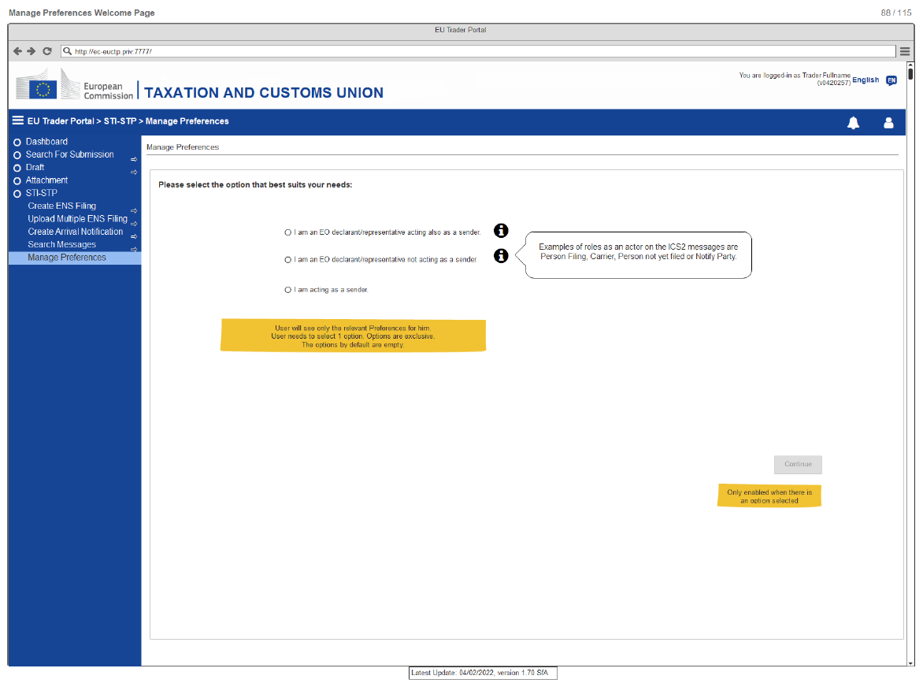
8. Use of STI-STP for the EOs CT campaign
Manage Preferences – Welcome Page

Slide 77
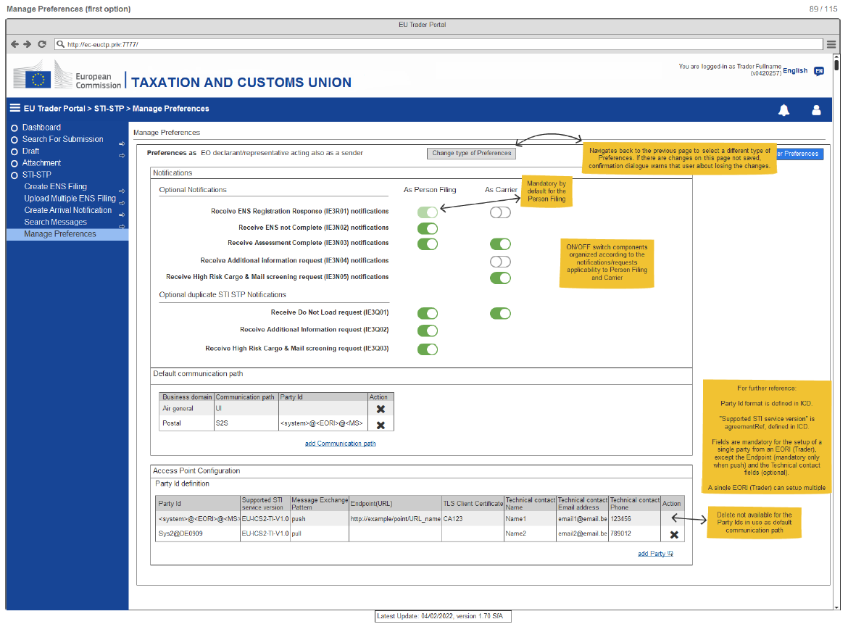
8. Use of STI-STP for the EOs CT campaign
Manage Preferences – First Option
This is an example of the first option ''EO declarant/representative acting also as a sender''

Slide 78
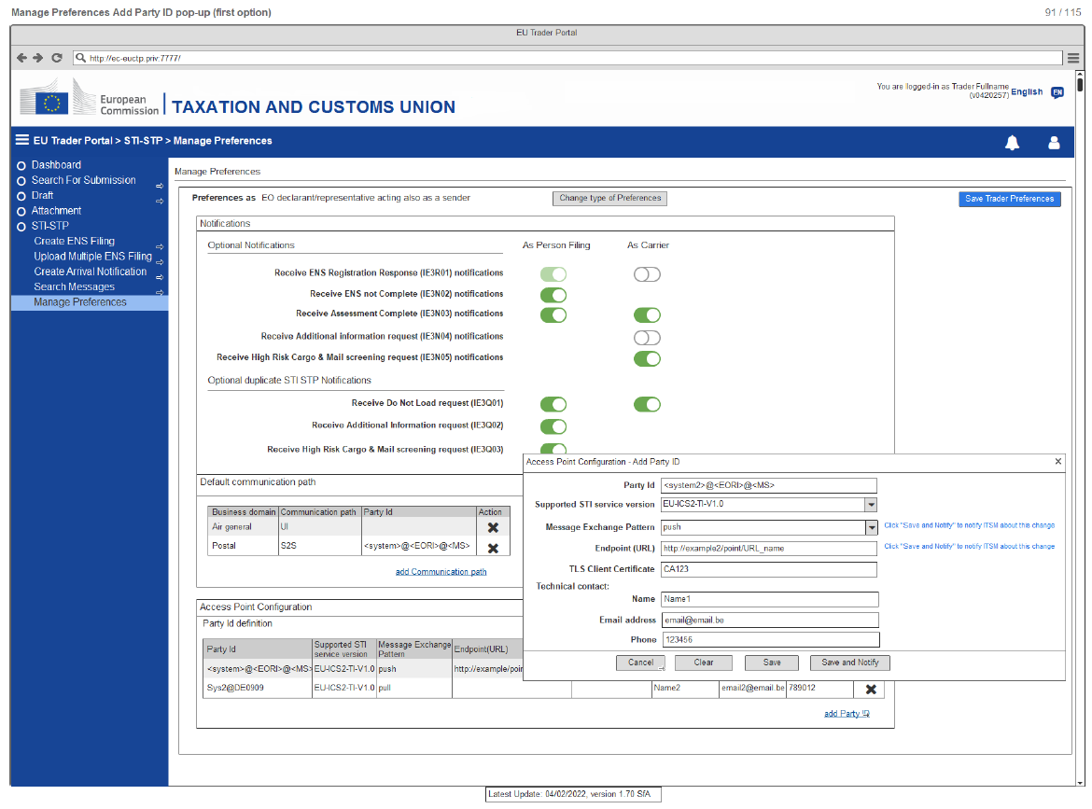
8. Use of STI-STP for the EOs CT campaign
Manage Preferences – Add Party ID
This is an example of the first option ''EO declarant/representative acting also as a sender''

Slide 79
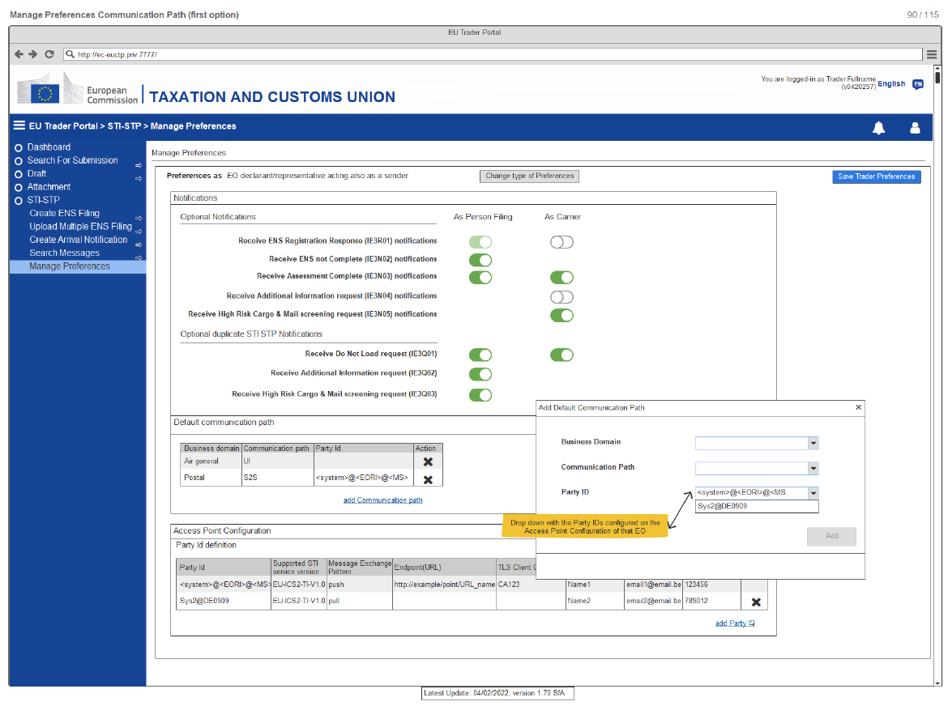
8. Use of STI-STP for the EOs CT campaign
Manage Preferences – Add Default Communication Path
This is an example of the first option ''EO declarant/representative acting also as a sender''

Slide 80
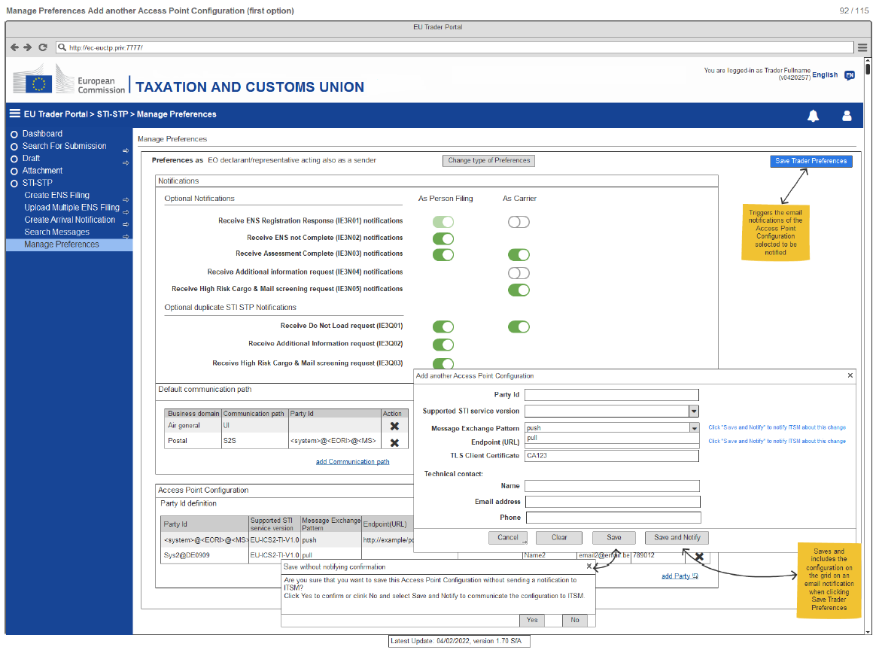
8. Use of STI-STP for the EOs CT campaign
Manage Preferences – Add another Access Point Configuration
This is an example of the first option ''EO declarant/representative acting also as a sender''

Slide 81
8. Use of STI-STP for the EOs CT campaign
Set Up a Conformance Campaign (3 out of 3)
Register a Self-Conformance Test campaign:
  EO selects ''Self-Conformance Test campaign'' from the STI-STP main menu
  The EO selects the ''Register'' button once all the configuration fields are filled
  EO selects a Business Role (depending on the role selection, a pre-defined set of business scenarios will be available for execution)
  EO fills in Identifiers (the LRN's of all ENS filings part of a business scenario) and user saves the configuration (Configuration will be stored in ICS2 STI of the CONF environment)
In the next slides there is graphical representation of STI-STP UI regarding the ''Self-Conformance Test campaign'' functionality

Slide 82
8. Use of STI-STP for the EOs CT campaign
Set Up a Conformance Campaign
Conformance Tests – Welcome Page
Conformance Tests – Configuration Not Filled
Conformance Tests – No Active EO CTC Loaded in STI
Business Role Selection (e.g., Carrier)
ENS Filing Selection (e.g., Carrier)
Scenario Configuration (e.g., Carrier)
View Registered Test Campaign (e.g., Carrier)

Slide 83
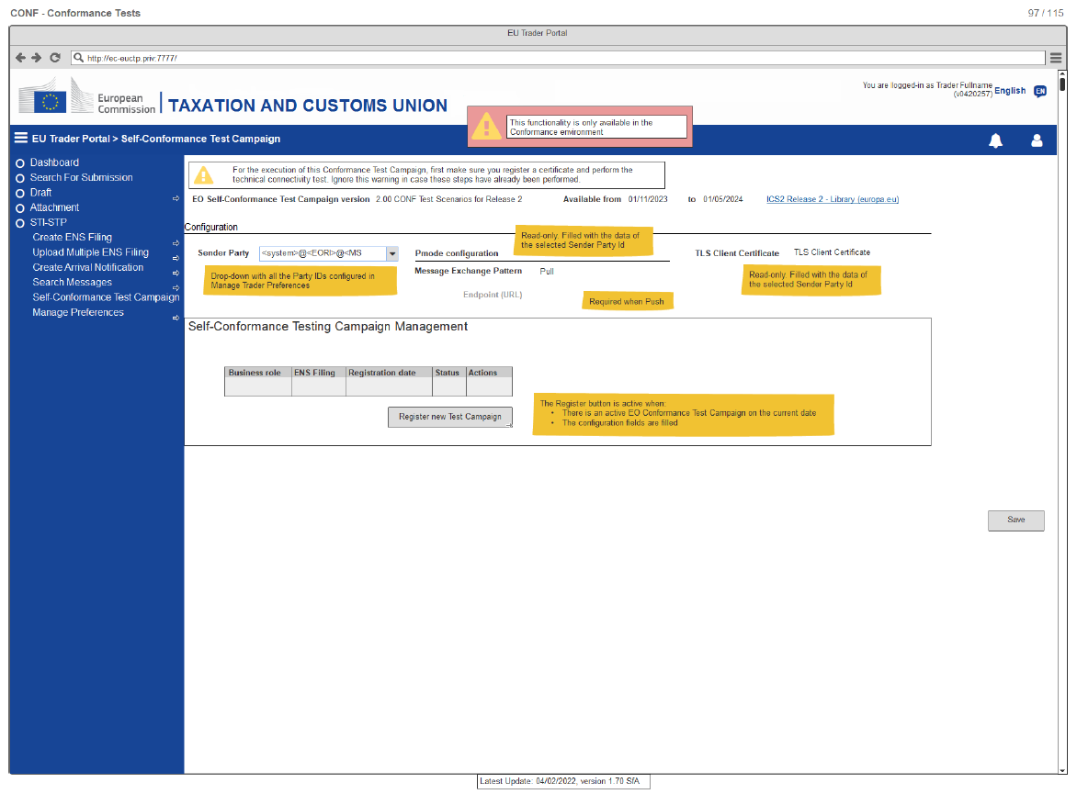
8. Use of STI-STP for the EOs CT campaign
Conformance Tests – Welcome Page

Slide 84
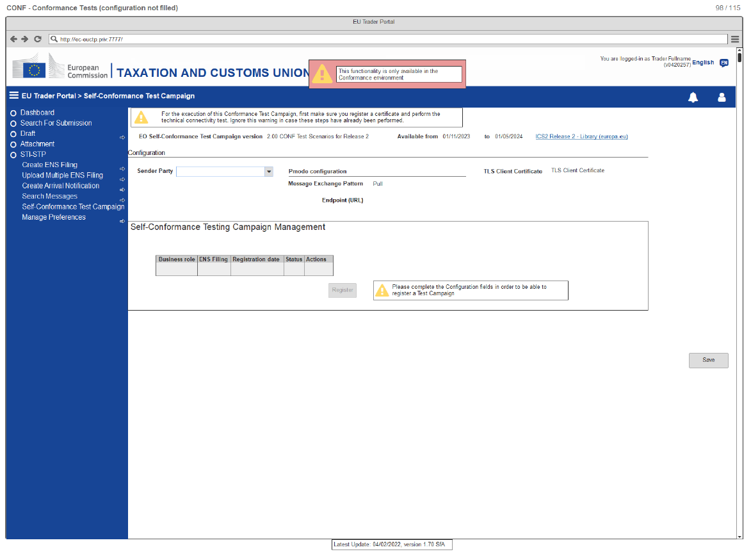
8. Use of STI-STP for the EOs CT campaign
Conformance Tests – Configuration Not Filled

Slide 85
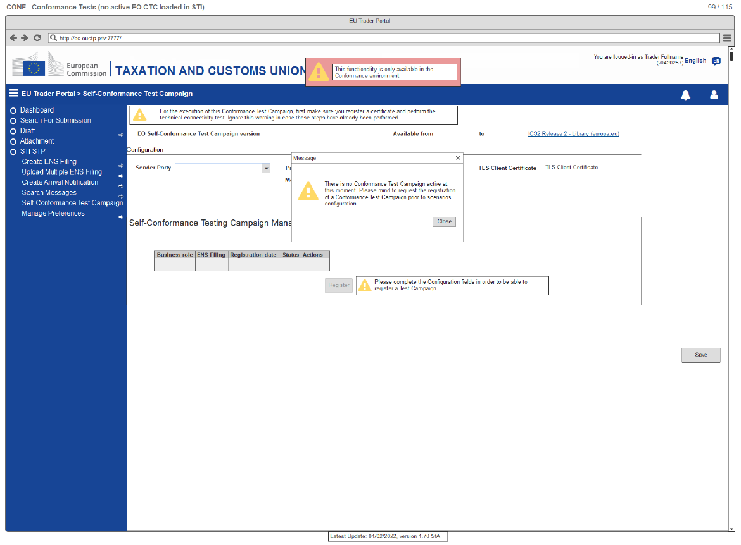
8. Use of STI-STP for the EOs CT campaign
Conformance Tests – No Active EO CTC Loaded in STI

Slide 86
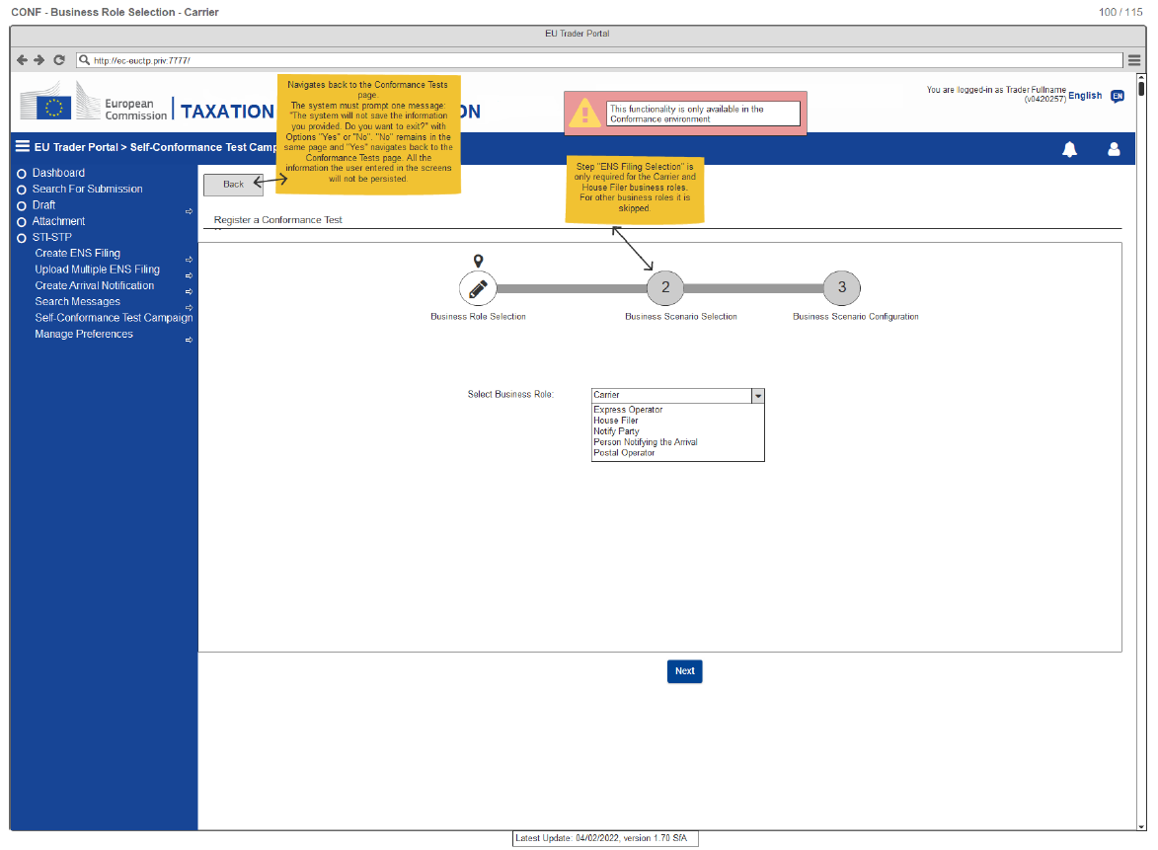
8. Use of STI-STP for the EOs CT campaign
Business Role Selection
This is an example of the business role ''Carrier''

Slide 87
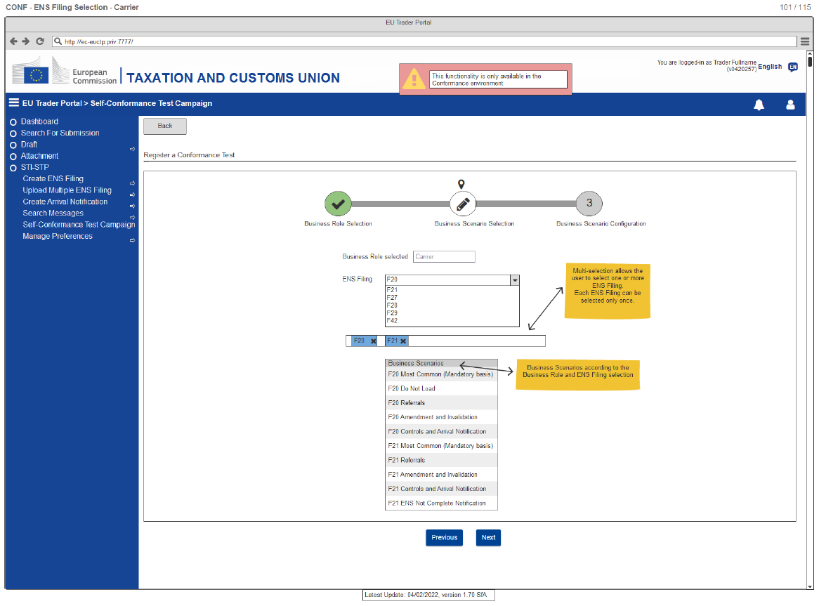
8. Use of STI-STP for the EOs CT campaign
ENS Filing Selection
This is an example of the business role ''Carrier''

Slide 88
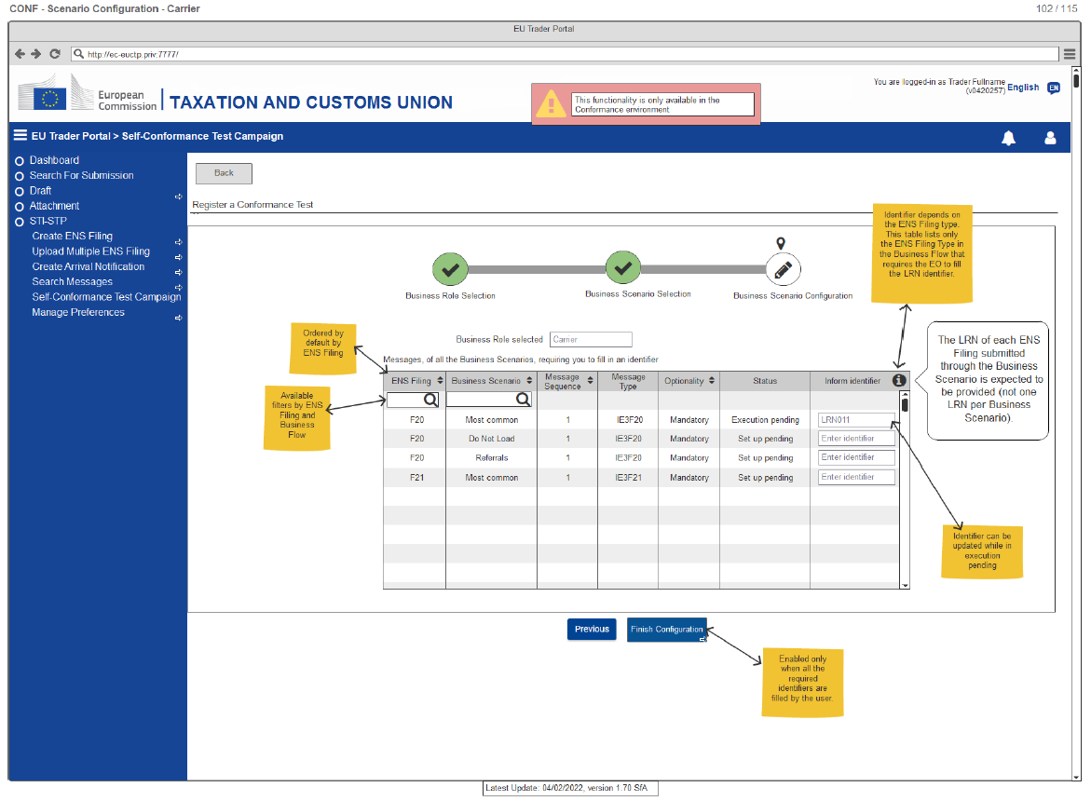
8. Use of STI-STP for the EOs CT campaign
Scenario Configuration
This is an example of the business role ''Carrier''

Slide 89
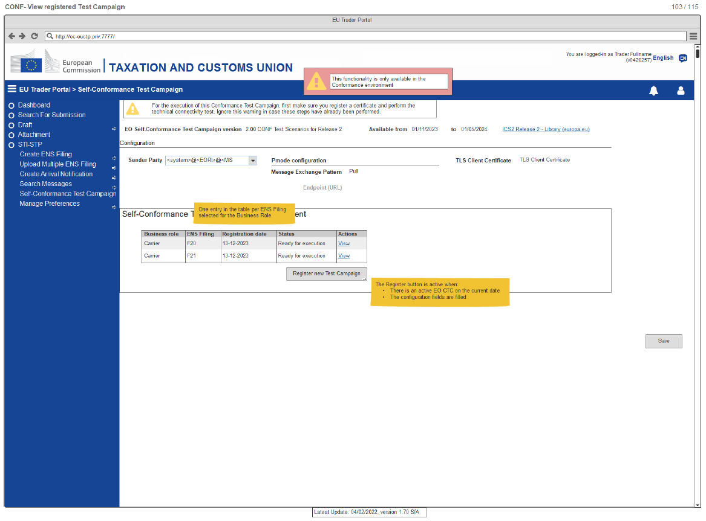
8. Use of STI-STP for the EOs CT campaign
View Registered Test Campaign
This is an example of the business role ''Carrier''

Slide 90
8. Use of STI-STP for the EOs CT campaign
Run the Conformance Campaign (1 out of 3)
This activity may last about 10 days
Remember: In order for EO to start running Self-Conformance Testing, the configuration of the environment must have first been completed from ITSM contractor [OPS]
Provide configurations fields in ICS2 STI-STP conformance test configuration screen:
  Provide the sender Party ID
  Select MEP (“push” or “pull”)
  Provide the Endpoint (i.e., URL) (Mandatory if the MEP is “push”)
  Provide the Certificate Authority that issues the TLS certificate

Slide 91
8. Use of STI-STP for the EOs CT campaign
Run the Conformance Campaign (2 out of 3)
All 3 steps are implemented by selecting ''Self-Conformance Test campaign'' from the STI-STP main menu as described previously
Select role according the EO type :
  Role can be Postal Operators, Express Operators, Notify Party, Person Notifying the arrival, Carriers or House Filers
Select type of ENS filings (in case of Carriers or House Filers):
  In case the selected Business role is Carrier or House Filer, then EO needs to select the types of ENS filings that are applicable to them
In the next slides there is graphical representation of STI-STP UI regarding the ''Self-Conformance Test campaign'' functionality

Slide 92
8. Use of STI-STP for the EOs CT campaign
Run the Conformance Campaign
Business Role Selection (e.g., Express Operator)
Scenario Configuration (e.g., Express Operator)
View Registered Test Campaign (e.g., Carrier & Express Operator)
View Business Flows (e.g., F20)
View Business Flows (e.g., F21)
View Message Flow

Slide 93
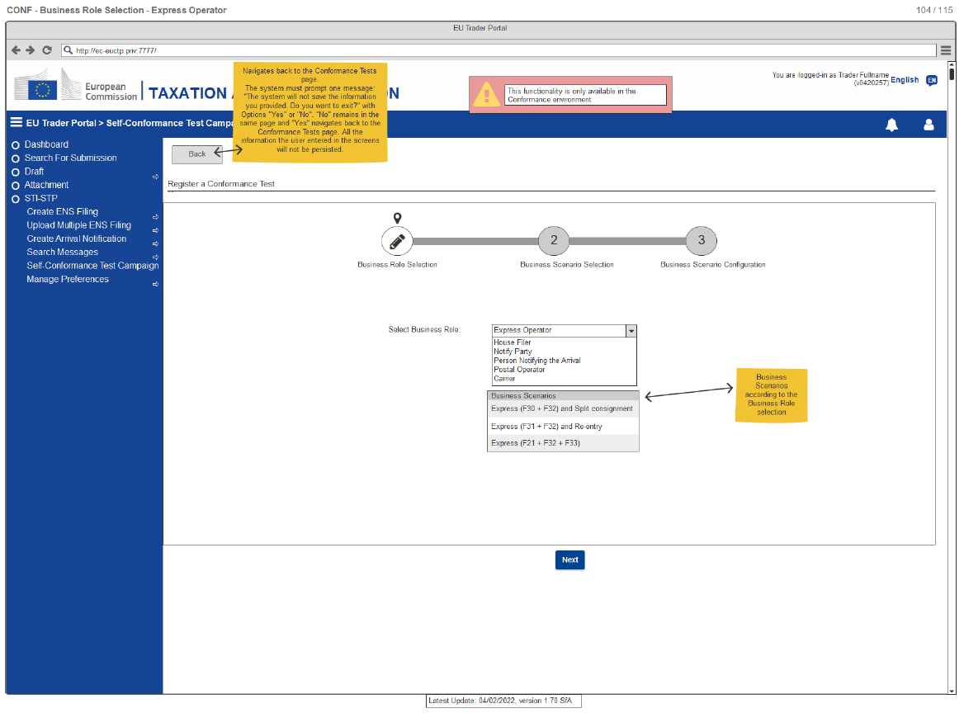
8. Use of STI-STP for the EOs CT campaign
Business Role Selection
This is an example of the business role ''Express Operator''

Slide 94
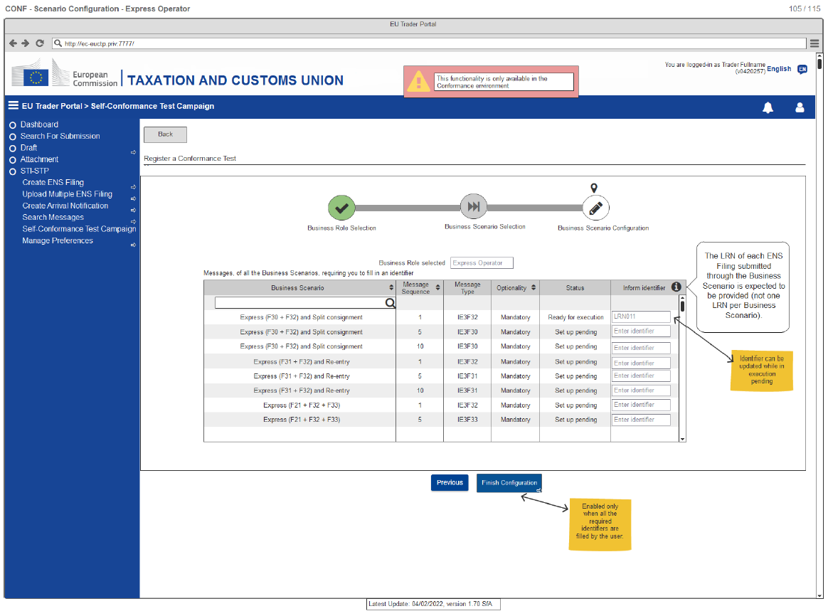
8. Use of STI-STP for the EOs CT campaign
Scenario Configuration
This is an example of the business role ''Express Operator''

Slide 95
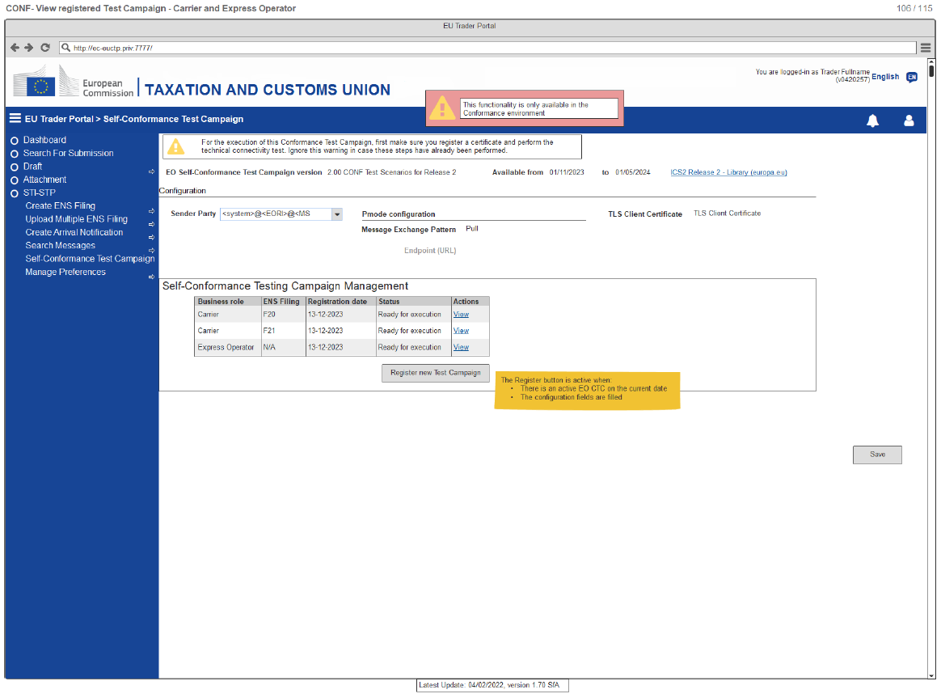
8. Use of STI-STP for the EOs CT campaign
View Registered Test Campaign
This is an example of the business role ''Express Operator'' & ''Carrier''

Slide 96
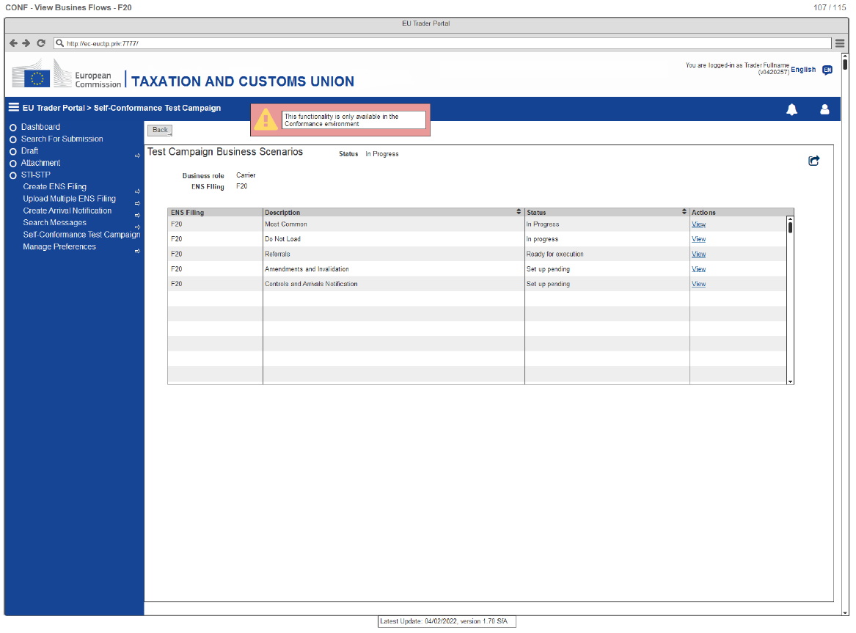
8. Use of STI-STP for the EOs CT campaign
View Business Flows (e.g., F20)

Slide 97

8. Use of STI-STP for the EOs CT campaign
View Business Flows (e.g., F21)

Slide 98
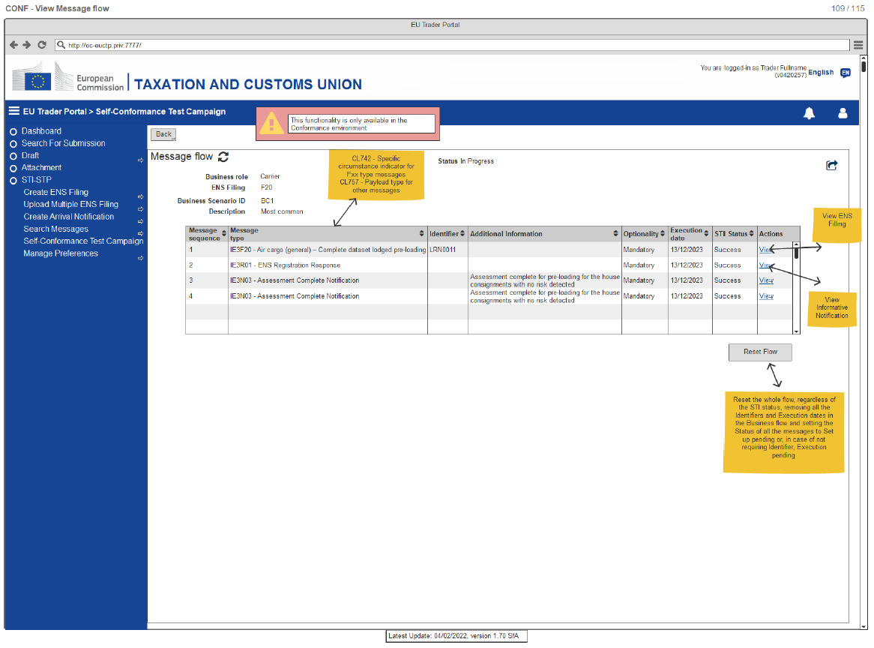
8. Use of STI-STP for the EOs CT campaign
View Message Flow

Slide 99
8. Use of STI-STP for the EOs CT campaign
Run the Conformance Campaign (3 out of 3)
Upon role and ENS filing (for Carriers & House Filers) selection, a set of business scenarios will be proposed for execution
Once the business scenario is triggered by the EO, an automated script is used:
  to simulate other EO business roles (if any in the scenario)
  to simulate NES messages
  to validate the successful completion of the business scenario
More information about the actual process of CT Self-conformance testing execution will be presented in Part 2 of this training module

Slide 100
8. Use of STI-STP for the EOs CT campaign
Validate the Conformance Campaign Results (1 out of 2)
The conformance campaign results are validated automatically
The exchanged messages per business scenario will be stored in ICS2 STI in CONF
Member States meaningfully support the validation process of EO Self-Conformance Testing
Member States follow up the status of the EO Self-Conformance Campaign by using MON&BS (CONF environment).
When the Campaign is successfully finished, the Member States should upload the successful Campaign in MON&BS (PROD environment).

Slide 101
8. Use of STI-STP for the EOs CT campaign
Validate the Conformance Campaign Results (2 out of 2)
Remember:
  A business flow is considered as successfully executed only if all inbound and outbound messages of that business flow are found
  In case there are some dependencies in the sample data and particular data values are expected, this is indicated in the steps of the business scenario
  No assertions on the content of the sample data will take place
  Message structure will be validated in order to comply with ICS2 CFSS & CTSS:
    No mandatory fields are missing from the exchanged messages
    No business rules and conditions are violated
    No code lists are violated
In case an EO lodges ENS filings for which they have not performed EO Self-Conformance, the impacted MSs can detect these “not compliant messages” using MON&BS (in PROD env) and contact them.

Slide 102
9. ICS2 R2 Documentation for EOs
Conformance Testing
Conformance Test Organisation Document for EO v1.20
TDS–Conformance Test Scenarios for EO v2.00
TDS–Conformance Test Cases for EO v1.40

Slide 103
9. ICS2 R2 Documentation for EOs
CFSS / CTSS latest versions
CFSS
ICS2 HTI Main
ICS2 Definitions
ICS2 HTI BPM L4 Process Description
ICS2 HTI Rules and Conditions
ICS2 HTI Code Lists
ICS2 HTI Information Exchange Specifications
CTSS
ICS2 Design Blueprint
HTI Interface Control Document
EO SSD packages
EO TSC packages
https://circabc.europa.eu/ui/group/cfss
https://circabc.europa.eu/ui/group/ctss

Slide 104
Conformance Baseline – CFSS/CTSS
Source of Documentation & Material
CIRCABC
https://circabc.europa.eu/ui/group/ea5f882b-9153-4fc1-9394-54ac8fe9149a/library/e23dba00-f6fd-4d2b-bf52-ec4450629d27
EOs can find useful CT material by accessing these webpages
Europa Webpage
https://ec.europa.eu/taxation_customs/customs-4/customs-security/import-control-system-2-ics2-0_en
https://ec.europa.eu/taxation_customs/dds2/taric/taric_consultation.jsp?Lang=en
https://ec.europa.eu/taxation_customs/dds2/rd/rd_download_home.jsp?Lang=en
https://ec.europa.eu/taxation_customs/dds2/eos/eori_home.jsp?Lang=en
Customs & Tax EU Learning Portal
https://customs-taxation.learning.europa.eu/

Slide 105


Slide 106

Thank you
© European Union 2022
Unless otherwise noted the reuse of this presentation is authorised under the CC BY 4.0 license. For any use or reproduction of elements that are not owned by the EU, permission may need to be sought directly from the respective right holders.
Notes:
Update/add/delete parts of the copy right notice where appropriate.
More information: https://myintracomm.ec.europa.eu/corp/intellectual-property/Documents/2019_Reuse-guidelines%28CC-BY%29.pdf

